Slide 1
Electronic mail security
enric Johnson

Slide 2
Pretty Good Privacy
Philip R. Zimmerman is the creator of PGP.
PGP provides a confidentiality and authentication service that can be used for electronic mail and file storage applications.

Slide 3
Why Is PGP Popular?
It is availiable free on a variety of platforms.
Based on well known algorithms.
Wide range of applicability
Not developed or controlled by governmental or standards organizations

Slide 4
Operational Description
Consist of five services:
  Authentication (Provided through DSS)
  Confidentiality (Done thru Symmetric Key Encryption algorithms)
  Compression (ZIP algorithm)
  E-mail compatibility (Using Radix 64 Conversion)
  Segmentation (to accommodate long e-mails)

Slide 5
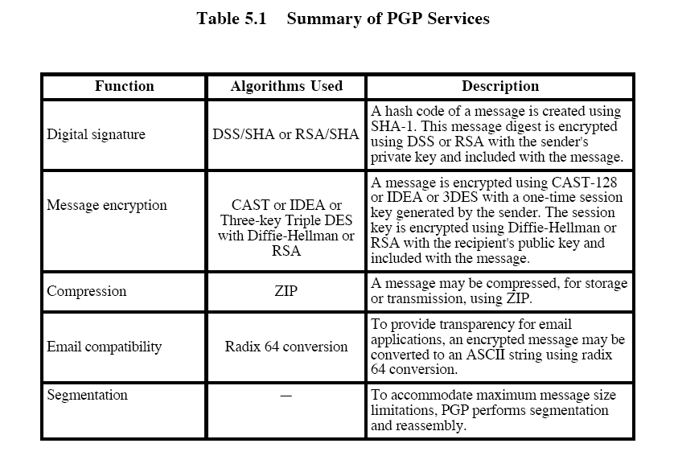

Slide 6
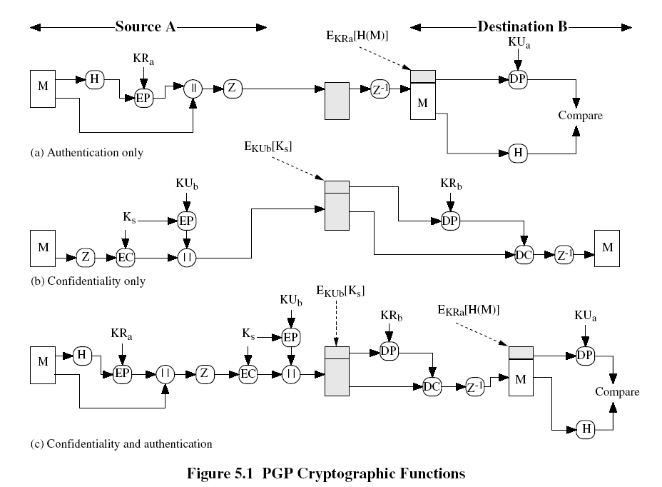

Slide 7
Compression
PGP compresses the message after applying the signature but before encryption
The placement of the compression algorithm is critical.
The compression algorithm used is ZIP

Slide 8
1.The signature is generated before compression for two reasons:
a. It is preferable to sign an uncompressed message so that one can store only uncompressed message together with signature for future verification.
b. Even if one were willing to generate dynamically a recompressed message for verification ,PGP’s compression is difficult.

Slide 9
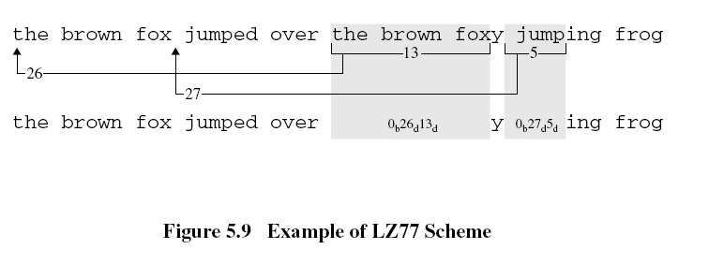

Slide 10
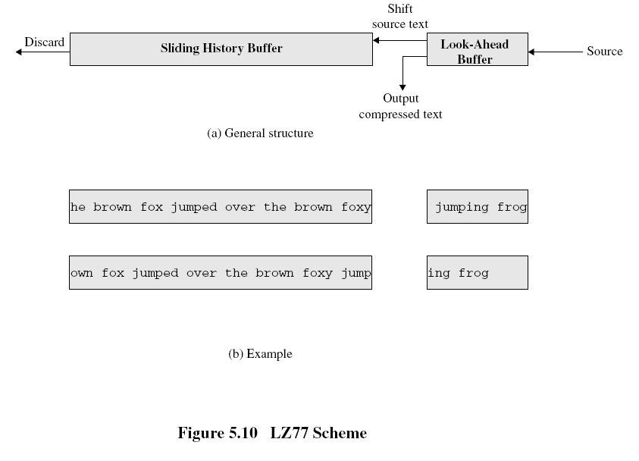

Slide 11
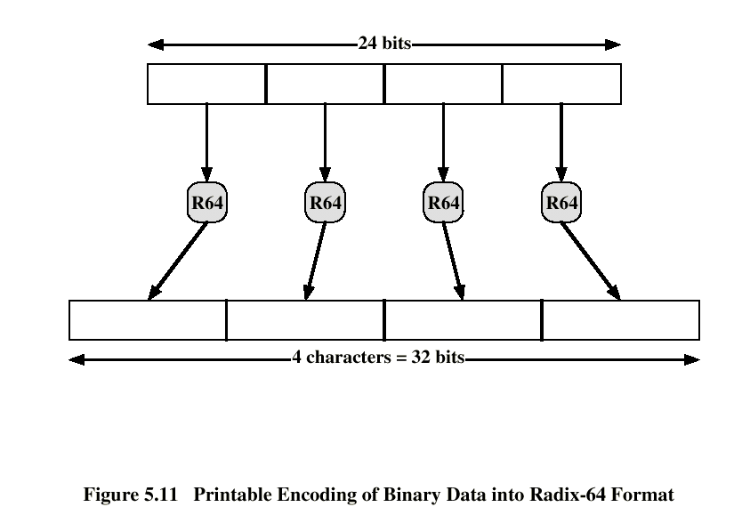
E-mail Compatibility
The scheme used is radix-64 conversion (see appendix 5B).
The use of radix-64 expands the message by 33%.
Henric Johnson

Slide 12
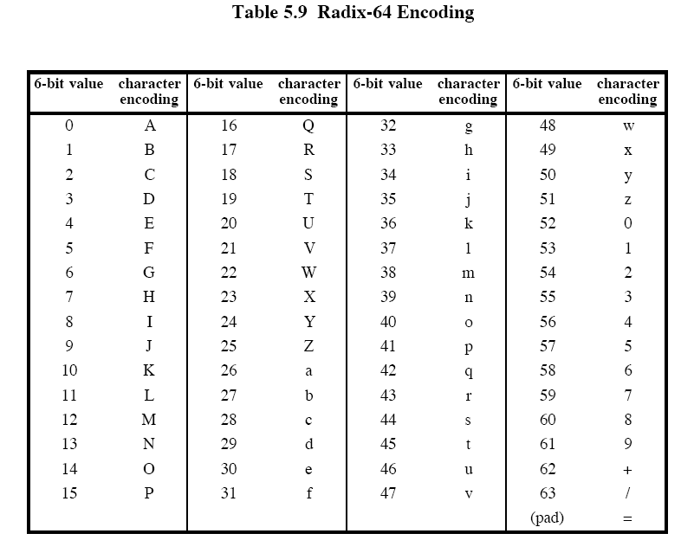

Slide 13
i/p : 00100011 01011100 10010001
2 3 5 C 9 1 (in hexadecimal)
arrange this input in blocks of 6 bits:
001000 110101 110010 010001
I 1 y R (in radix-64)
If these characters are stored in 8-bit ASCII format with parity bit set to zero , we have
01001001 00110001 01111001 01010010
o/p : 4 9 3 1 7 9 5 2

Slide 14
Segmentation and Reassembly
Often restricted to a maximum message length of 50,000 octets.
Longer messages must be broken up into segments.
PGP automatically subdivides a message that is too large.
The receiver strip of all e-mail headers and reassemble the block.

Slide 15
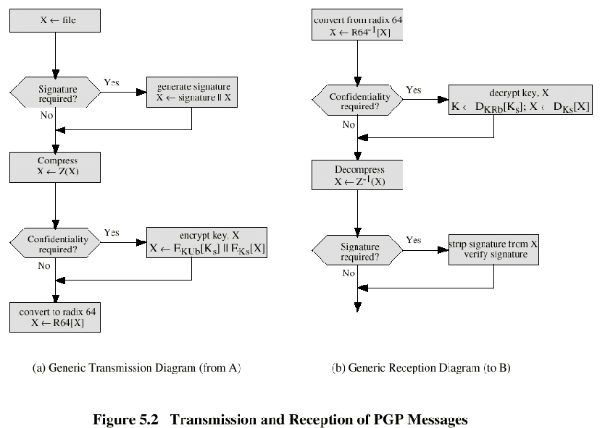

Slide 16
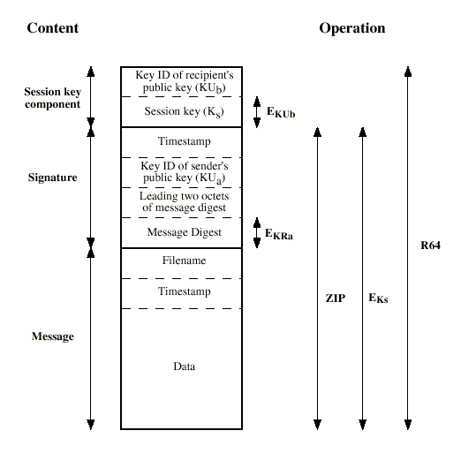
Format of PGP Message
Henric Johnson

Slide 17
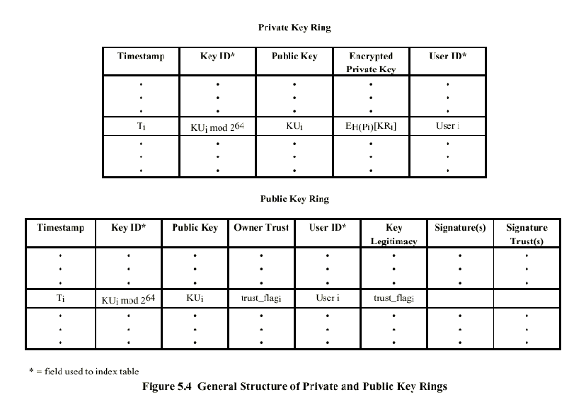

Slide 18
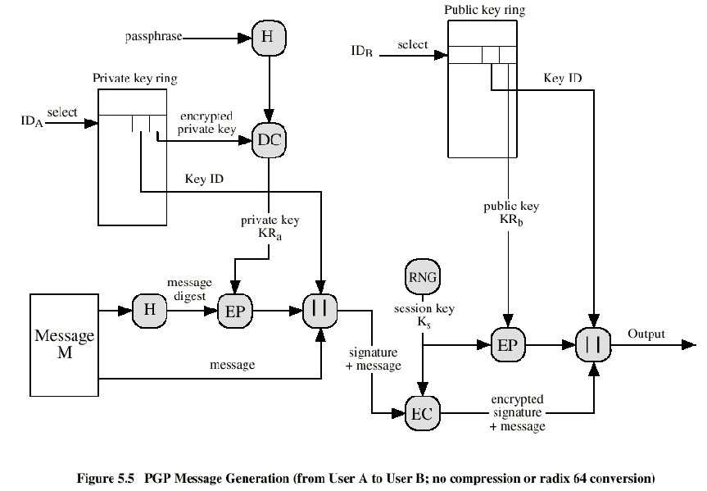

Slide 19
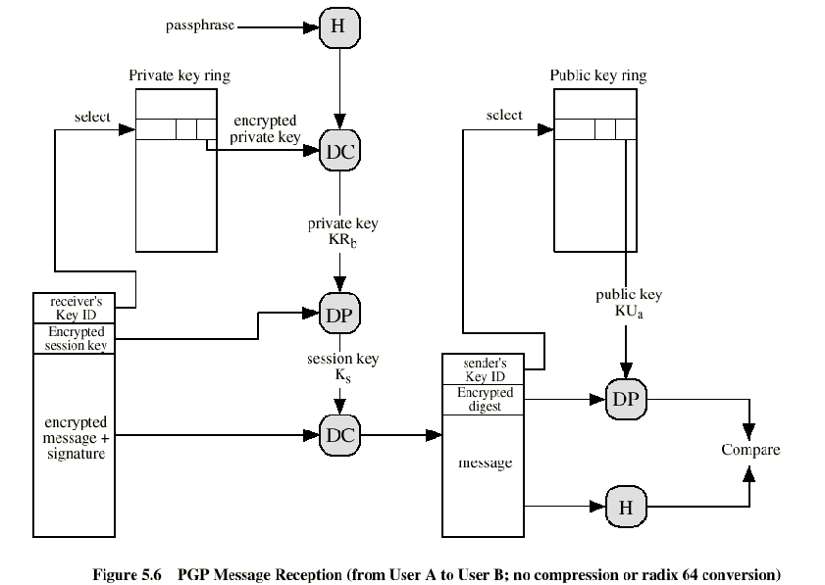

Slide 20
The Use of Trust
Key legitimacy field
Signature trust field
Owner trust field

Slide 21
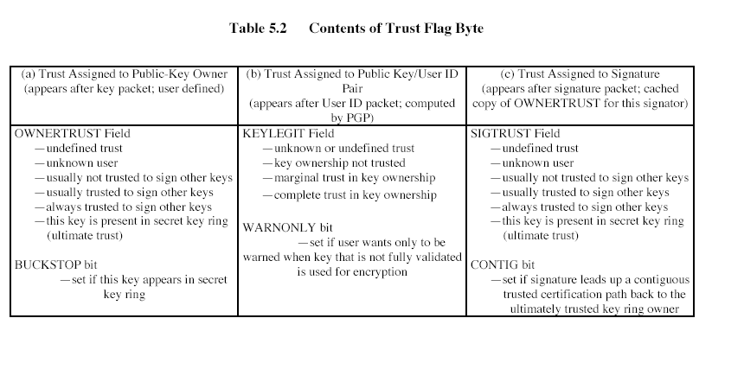

Slide 22
Revoking Public Keys
The owner issue a key revocation certificate.
Normal signature certificate with a revote indicator.
Corresponding private key is used to sign the certificate.

Slide 23
S/MIME
Secure/Multipurpose Internet Mail Extension
S/MIME will probably emerge as the industry standard.
PGP for personal e-mail security

Slide 24
Simple Mail Transfer Protocol (SMTP, RFC 822)
SMTP Limitations - Can not transmit, or has a problem with:
  executable files, or other binary files (jpeg image)
  “national language” characters (non-ASCII)
  messages over a certain size
  ASCII to EBCDIC translation problems
  lines longer than a certain length (72 to 254 characters)

Slide 25
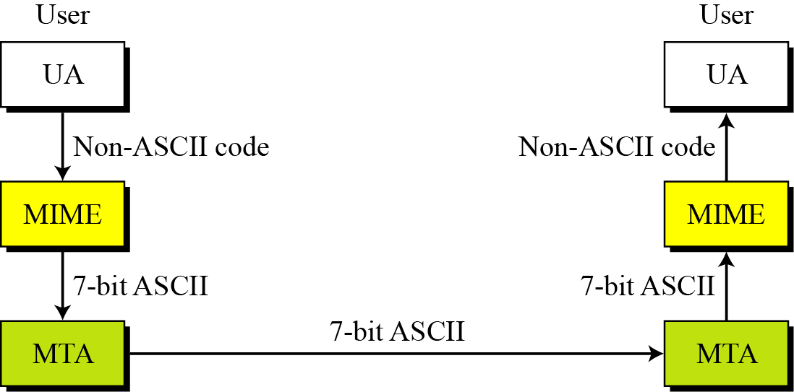
Figure MIME

Slide 26
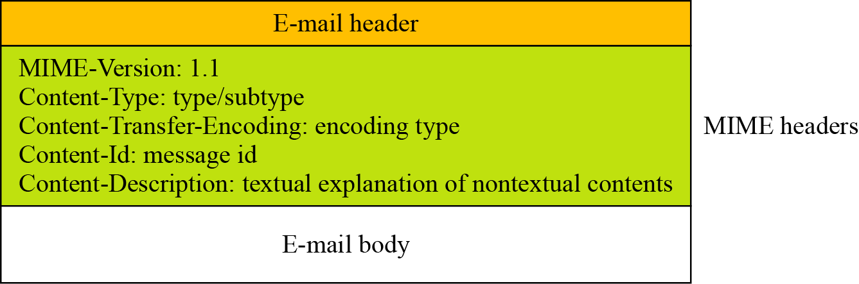
Figure MIME header

Slide 27
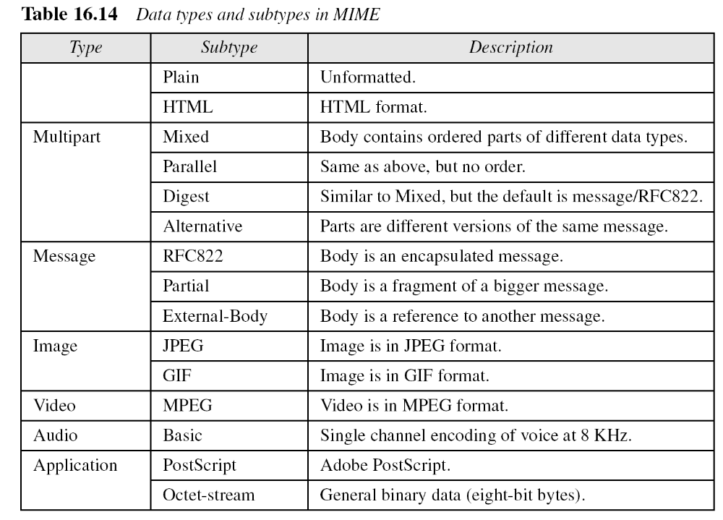

Slide 28
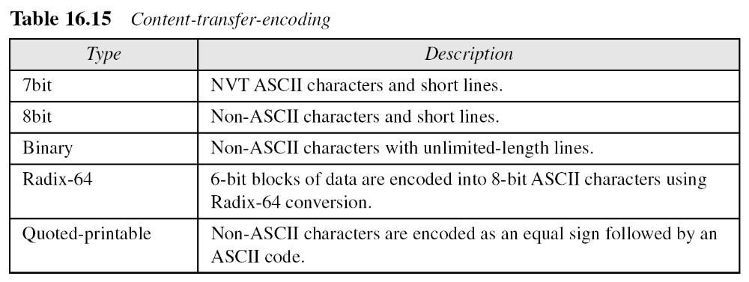

Slide 29
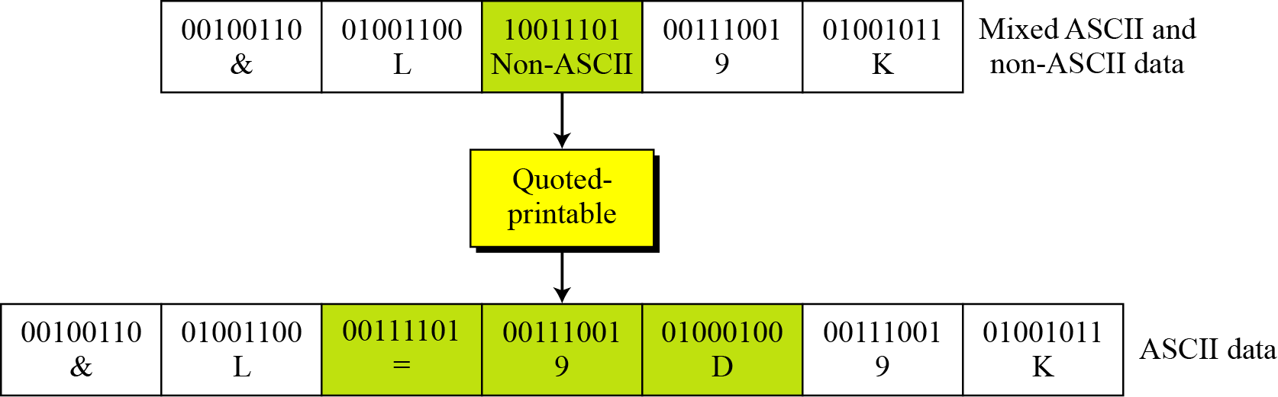
Figure Quoted-printable

Slide 30
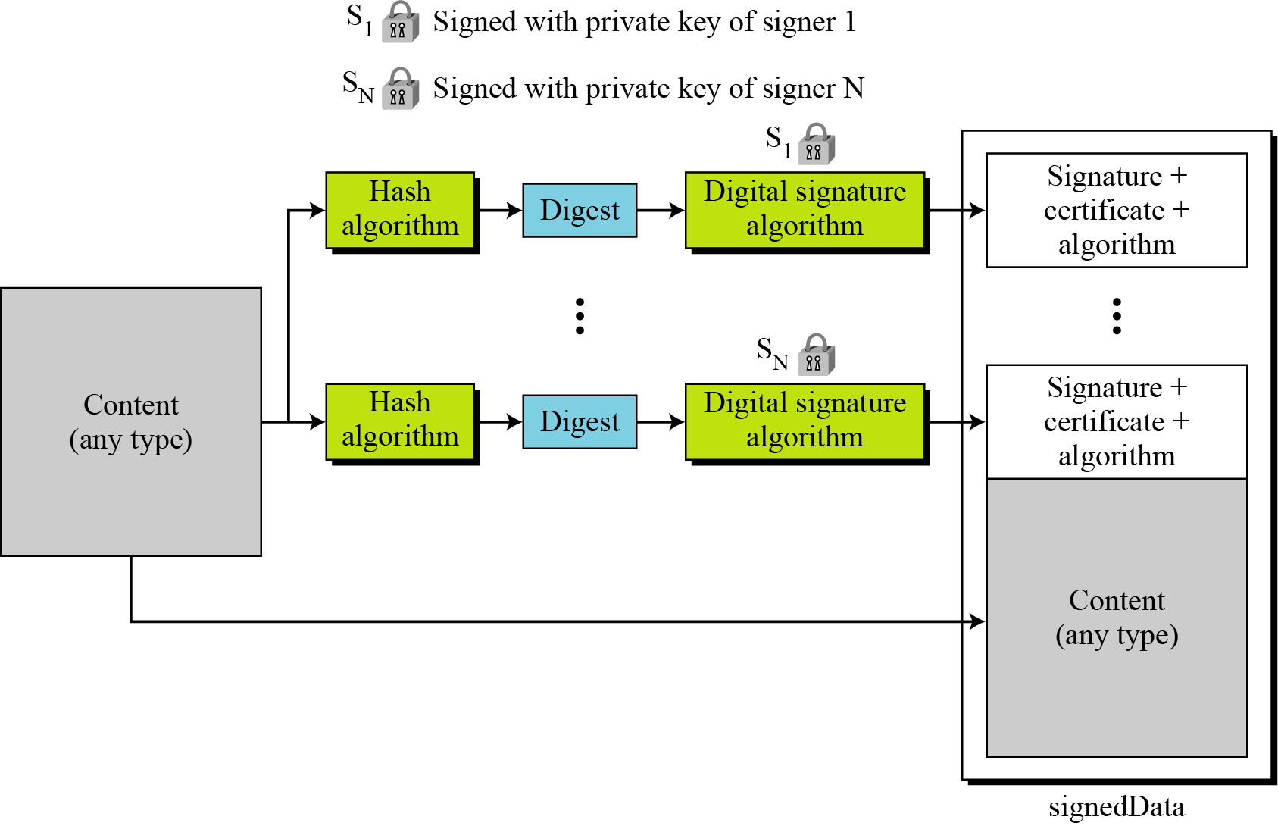
S/MIME
Figure Signed-data content type

Slide 31
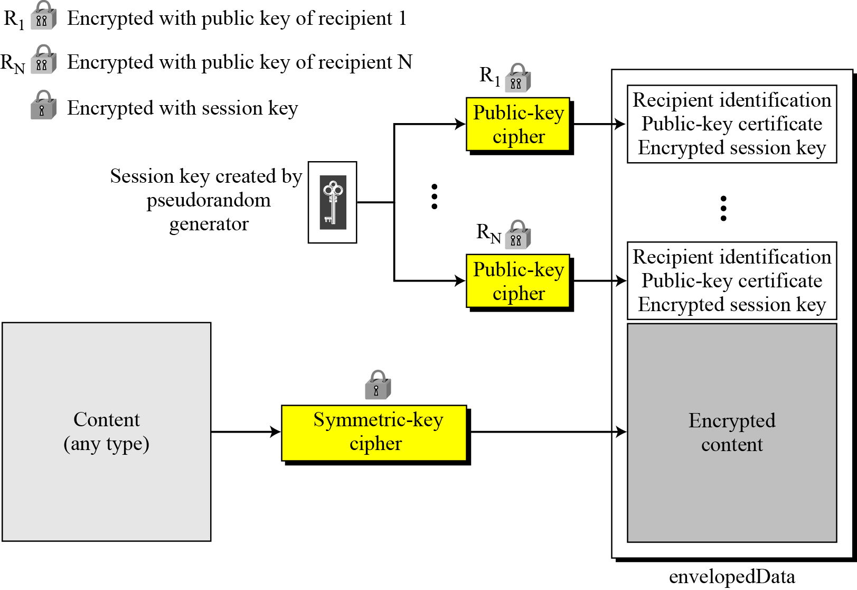
Enveloped-data content type

Slide 32
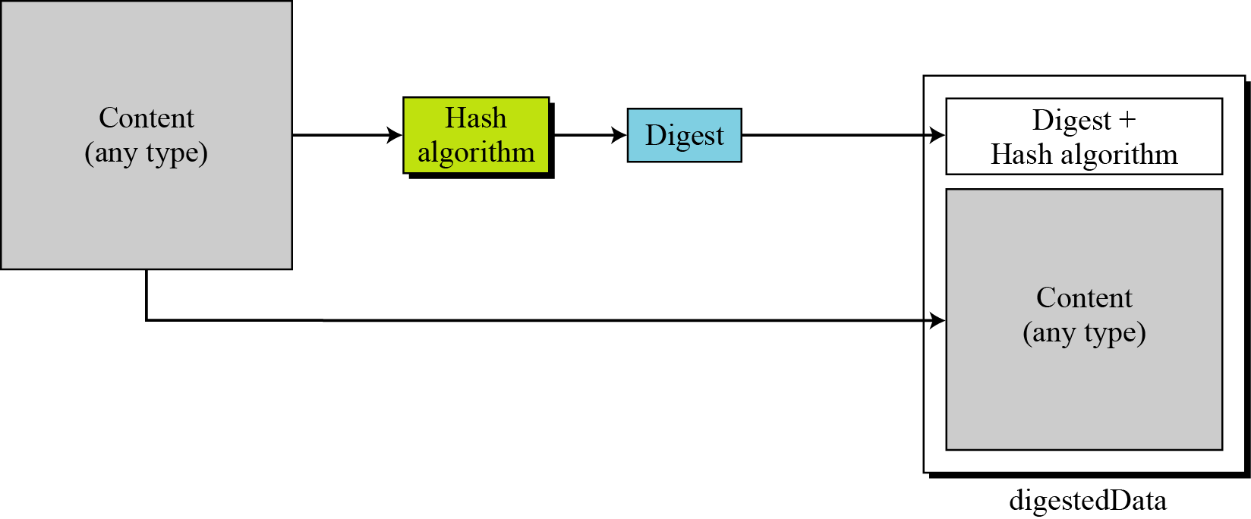
Figure Digest-data content type

Slide 33
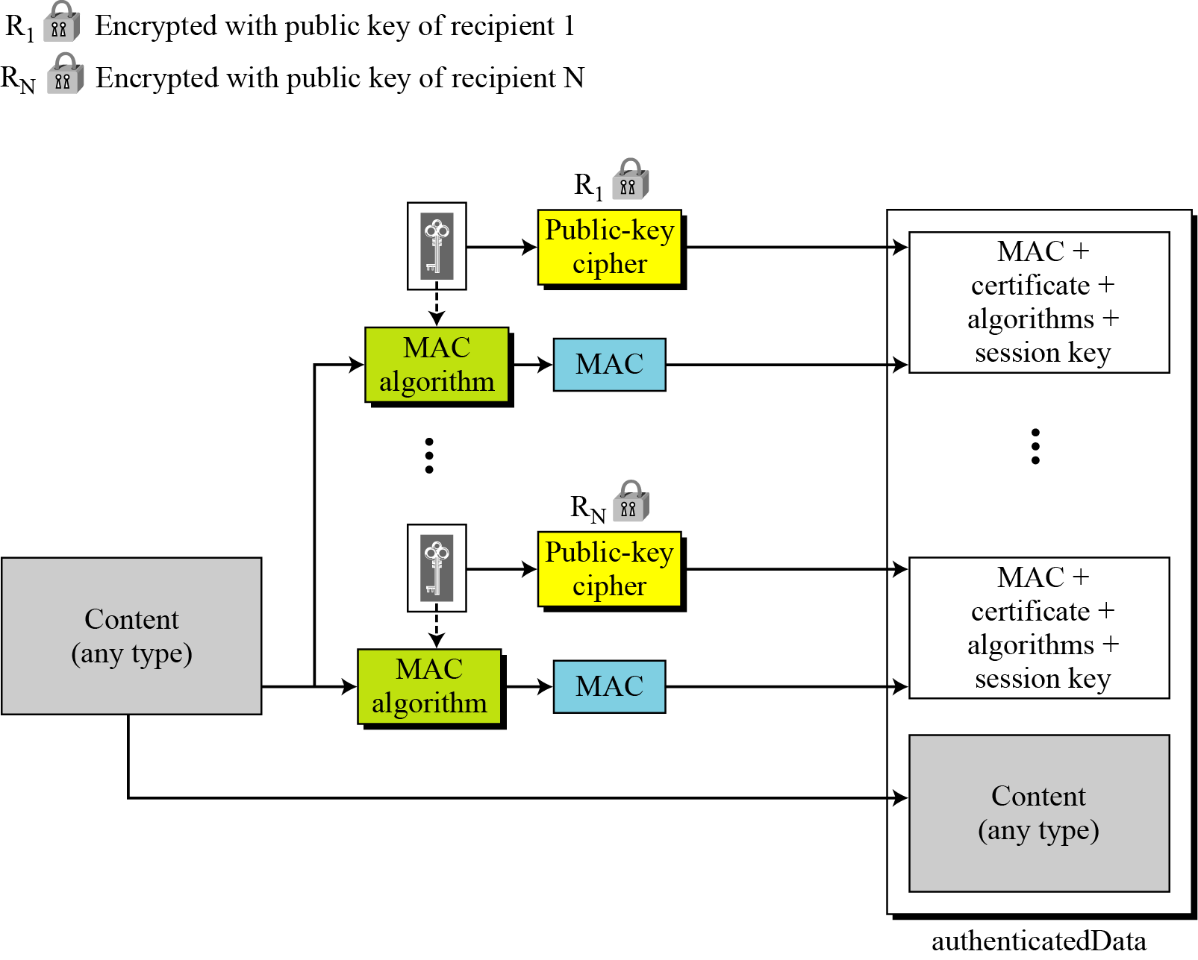
Figure Authenticated-data content type

Slide 34
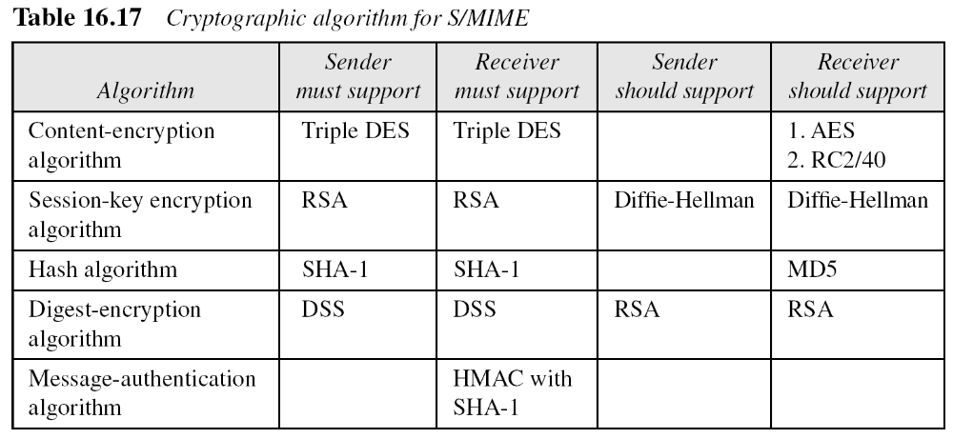

Slide 35
S/MIME Functions
Enveloped Data: Encrypted content and encrypted session keys for recipients.
Signed Data: Message Digest encrypted with private key of “signer.”
Clear-Signed Data: Signed but not encrypted.
Signed and Enveloped Data: Various orderings for encrypting and signing.

Slide 36
User Agent Role
S/MIME uses Public-Key Certificates - X.509 version 3 signed by Certification Authority
Functions:
  Key Generation - Diffie-Hellman, DSS, and RSA key-pairs.
  Registration - Public keys must be registered with X.509 CA.
  Certificate Storage - Local (as in browser application) for different services.

